Slide 1
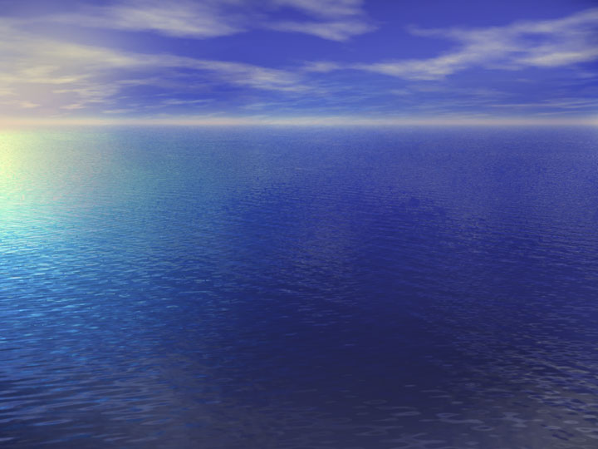

Things that I love (my friends)
Anna, Judy ,Latoya ,Patrice, and Willynn
Grimey Gurlz
4-lyfe!

Slide 2
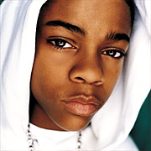
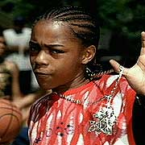
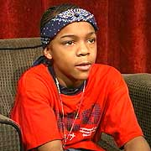
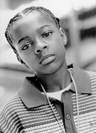
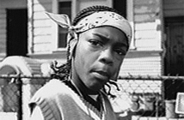

Everyone knows I love Lil' Bow Wow
Lil' Bow Wow you just don't know the way you move so fast across the floor...

Slide 3
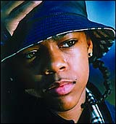
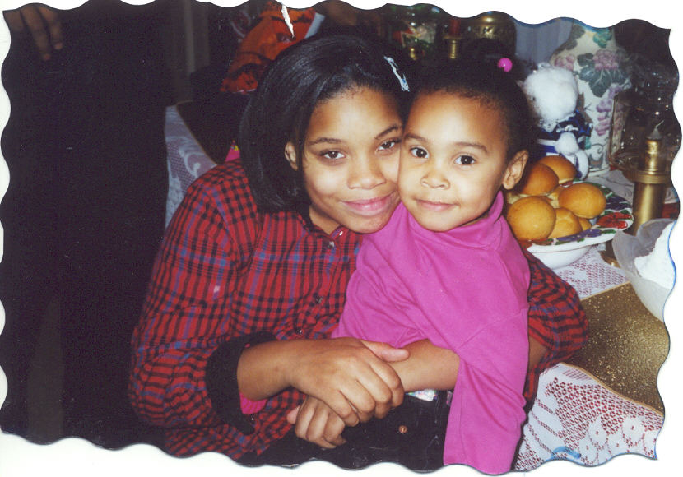

Shad Gregory Moss & Judy Angelica Berry ~4-lyfe!~
Don't hate!

Slide 4
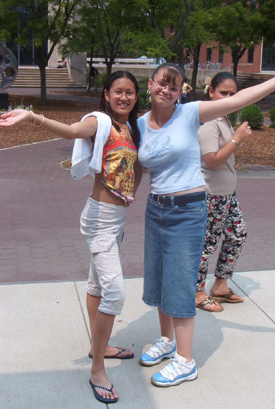

Anna aka {the boy lover} (the one with the baby blue)
(aka) sexychick

Slide 5

Me (the loud one)
(aka)cray_z_one

Slide 6

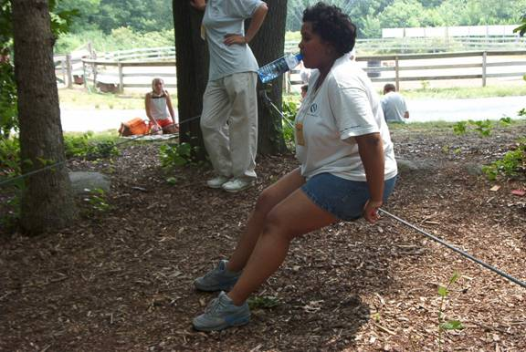
Latoya (the mean one)
(aka) scrumptious

Slide 7
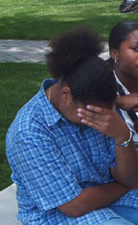

Patrice (the camera shy one)
(aka) pat_rice
(bka)puffy

Slide 8
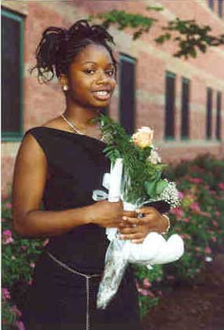

Willynn (the quiet one) (sometimes)
(aka) fattygurl

Slide 9
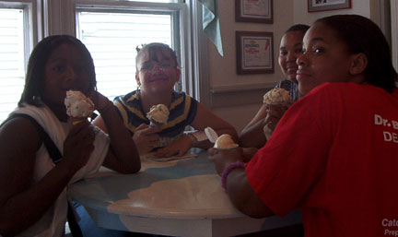
My gurlz 4-lyfe I will never forget this summer!
(the only one that’s missing is Patrice)
love ya'll so much don't ever forget that!

Slide 10


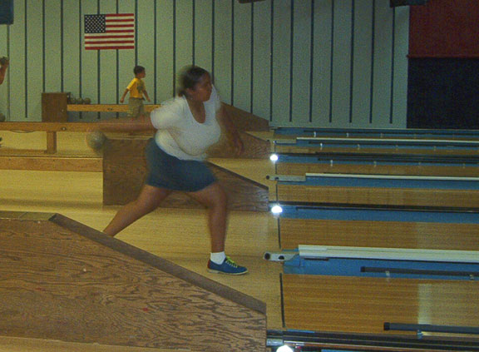
Precious memories
Anna (the day that she got robbed by Willynn and me)
Latoya (when she tripped in the bowling alley trying to be Michael Jackson
Patrice (just the way you talk fast)
Willynn (getting us lost all the time)
Go Micheal Go!!!!

Slide 11

My girl Patrice (the one who never wants to be in any of our pictures) we will never forget you combat boots!

Slide 12
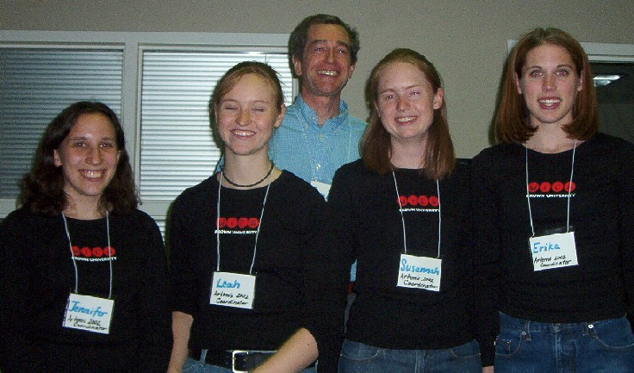
Thank you’ s 2:
Erika (elf)
Jen (Grimey) (your one of us)
Leah (elp)
Susannah (Sue)
Love always, artemis project 2002

Slide 13
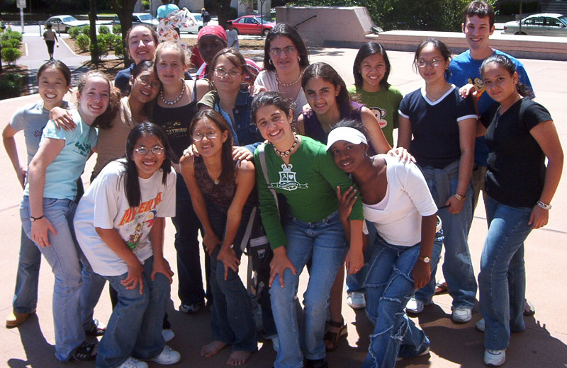
Here is a picture of everyone in Artemis! Say cheese!
Artemis 2002

Slide 14
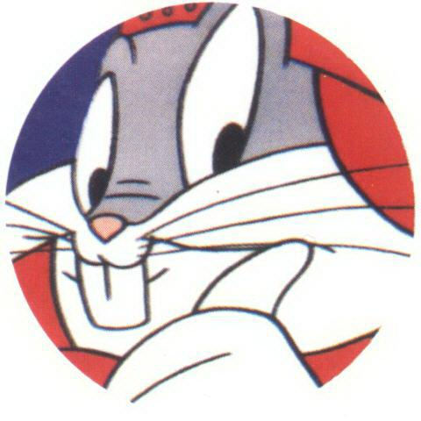
Hope you enjoyed your stay!
That’s all folks! Buh-bye

Slide 15
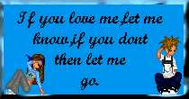

Quotes for you to leave with

